Slide 1

Getting Started with Text Classification
PyData Global Conference 2021
Nabanita Roy

Slide 2





About the dataset
Exploratory Data Analysis
Text Pre-processing
Training a Binary Classifier
Model Evaluation
Predict
if Tweets are about
Real Disasters
PyData Global Conference 2021

Slide 3
What is Natural Language?
What is Natural Language Processing?
Where does NLP fit in the AI ecosystem?
PyData Global Conference 2021

Slide 4


Do you want to build machines or computer applications?
Do you want a machine to listen and act like humans do?
Technological
Goals
Cognitive
Goals
PyData Global Conference 2021

Slide 5
Text Classification
Using
Supervised
Machine Learning
Assigning pre-defined categories to text documents.
Target / Label is the term for the pre-defined categories.
Example:
Is an email spam?
Is a news article about politics, business, or sports?
Gender Identification
Sentiment Analysis – If a review is positive or negative?
PyData Global Conference 2021

Slide 6
Regex and text extraction
Tokenization
Case Conversion
Noise Removal
Accents
HTML Tags
Symbols/ Emojis
Contractions ( Example : I’ll -> I will )
Stopwords ( Example : are, is, the)
Normalization ( Example: visited -> visit)
Parts-of-Speech Tagging
Named Entity Recognition
Text Processing Techniques
PyData Global Conference 2021

Slide 7
Example:
I just saw Barrack Obama in !
-> [‘I’, ‘ just’, ‘see’, ‘barrack’, ‘obama’]
<p> I’ll see you soon ☺ <3, mon chéri <p>
‘I’, ‘will’, ‘see’, ‘you’, ‘soon’, ‘mon’, ‘cherie’
Text Processing Techniques
PyData Global Conference 2021

Slide 8
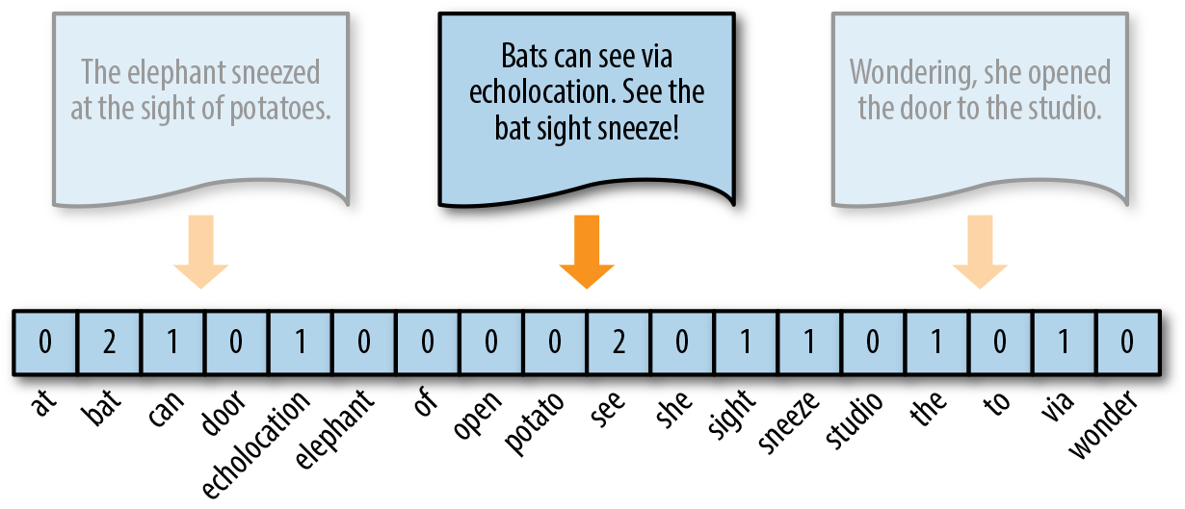
Text Vectorization or Text Representations for Machine Learning
Machine Learning
models quantifies
everything.
Therefore,
numeric representation
for texts is required
as input an ML model.
Image ref: https://towardsdatascience.com/from-word-embeddings-to-pretrained-language-models-a-new-age-in-nlp-part-1-7ed0c7f3dfc5
PyData Global Conference 2021

Slide 9
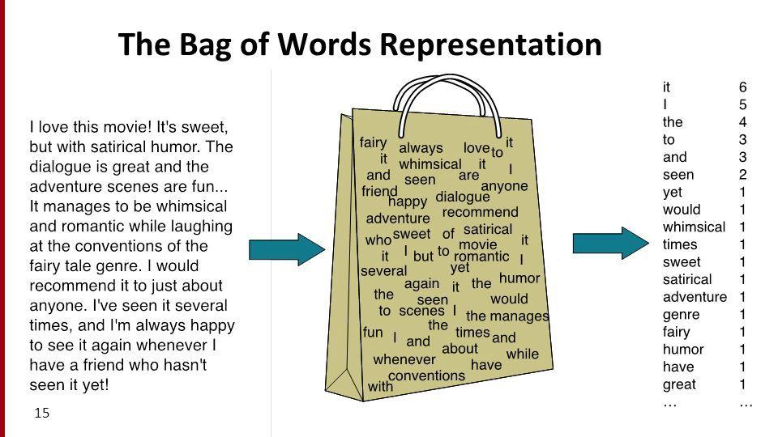
Statistical
Models:
Bag of Words
In a Bag of Words or BoW, bag refers to an unordered list of words which allows multiple occurrences of the words. Position of the words is ignored and Frequency (the number of occurrences) of a token is considered.
Image ref: https://sep.com/blog/a-bag-of-words-levels-of-language/
PyData Global Conference 2021

Slide 10
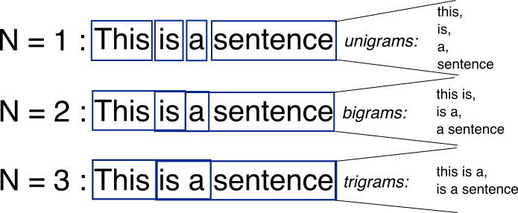
Statistical
Models:
N-Grams
Takes into account N tokens occurring in a sequence.
Image ref: http://rstudio-pubs-static.s3.amazonaws.com/460514_4377b4f645a944d788ae7300782123f3.html
PyData Global Conference 2021

Slide 11
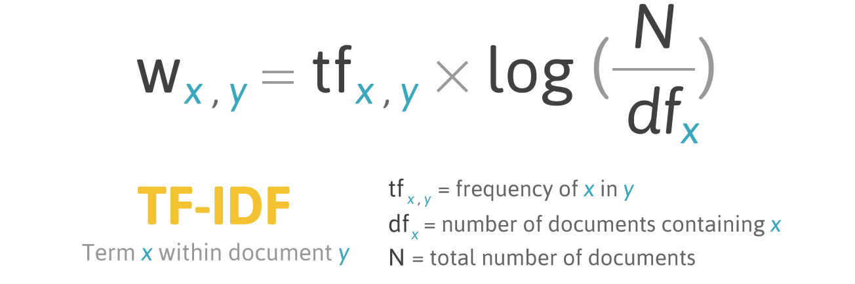
Use log to dampen the effect of large corpus
Statistical
Models:
TF-IDF
Documents are converted to vector models (or vectorized form) using the number of the times a token appears in one document and in all the documents.
Order is ignored.
(df+1) is used instead for terms that do not occur in the vocabulary to avoid Zero Division.
Image ref: http://filotechnologia.blogspot.com/2014/01/a-simple-java-class-for-tfidf-scoring.html
PyData Global Conference 2021

Slide 12
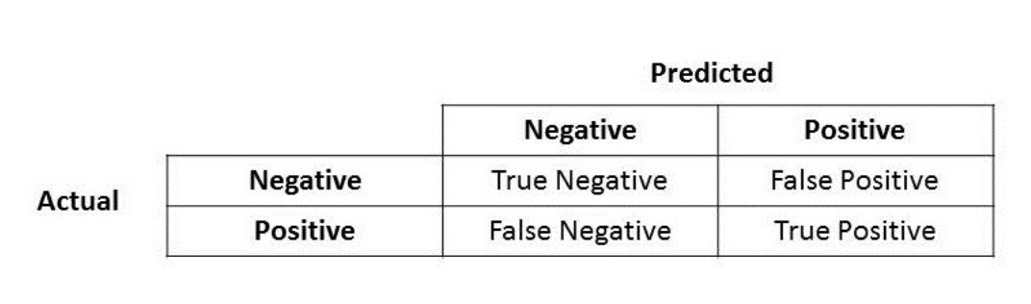
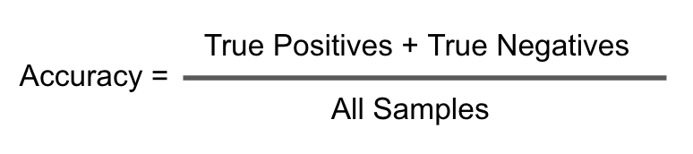
Model Evaluation
for
Text Classification
PyData Global Conference 2021

Slide 13
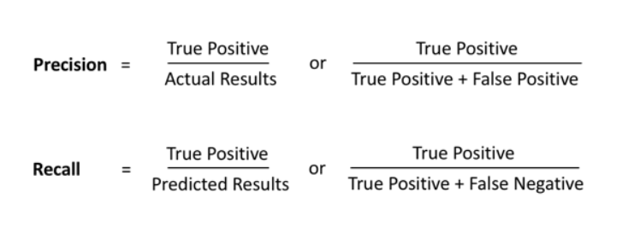
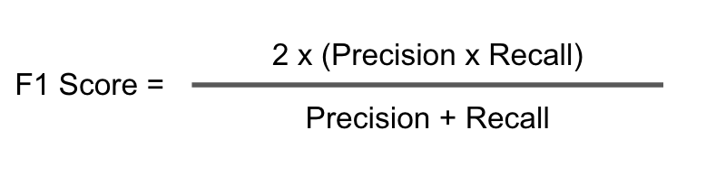
Model Evaluation
for
Text Classification
Recall
Precision
PyData Global Conference 2021

Slide 14
Thank You
Q/A
PyData Global Conference 2021

